Slide 1

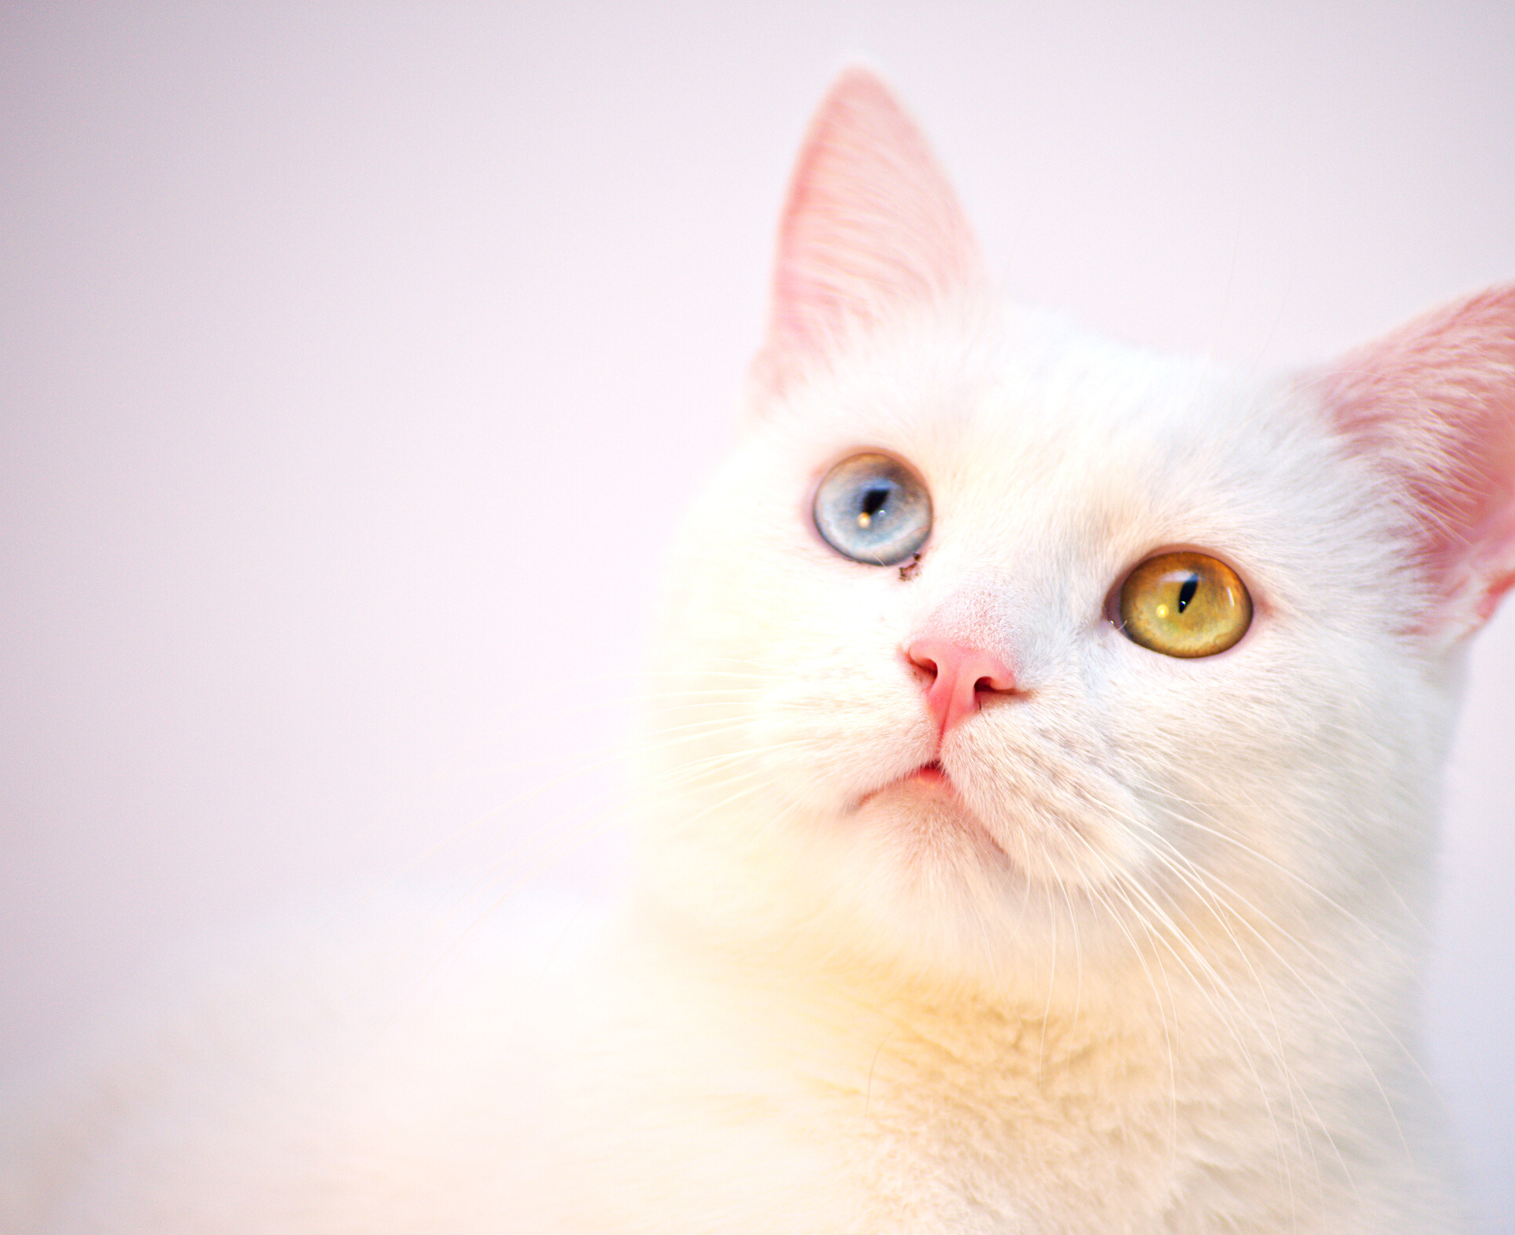

PET SHELTER
Author: Valeriia Lebedieva

Slide 2
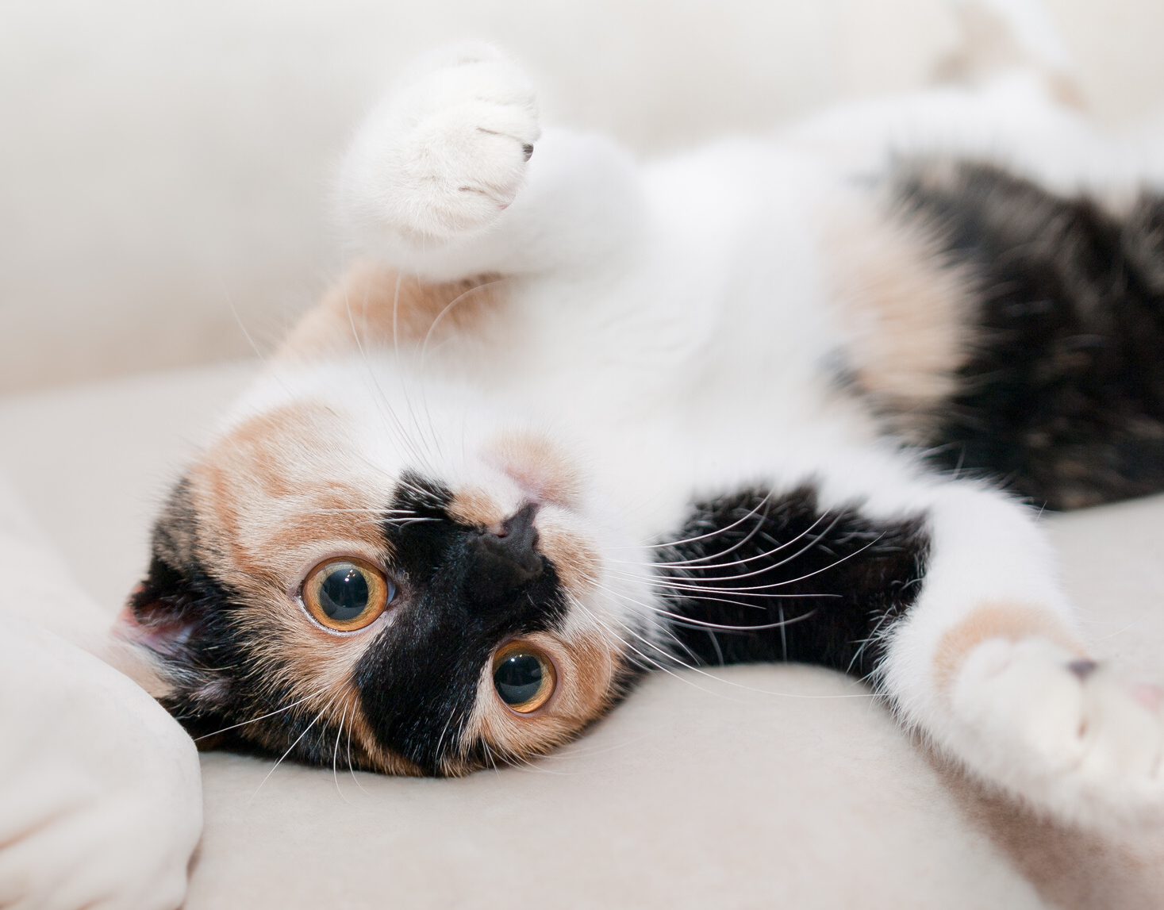
What is this
project
for?

Slide 3
Project goals
- adding information about a new animal (sections for cats and dogs)
- display detailed information about a particular animal
- adding and editing breeds for cats and dogs
- adding, editing, display useful information (articles, photos, videos) on the care, nutrition and training of animals in the "Posts" section
- sending notifications by email about a new post to all subscribers
- view current weather with automatic geolocation of your city and exchange rates for UAH (REST service)
- Google authentication
- registration of a new user with the ability to subscribe
- display of necessary information and allowed features depending on user roles

Slide 4
Application creation steps:
1. Functional development, making a list of requirements
2. Implementing a business application layer
3. Implementation of the client part of the application
4. Testing

Slide 5
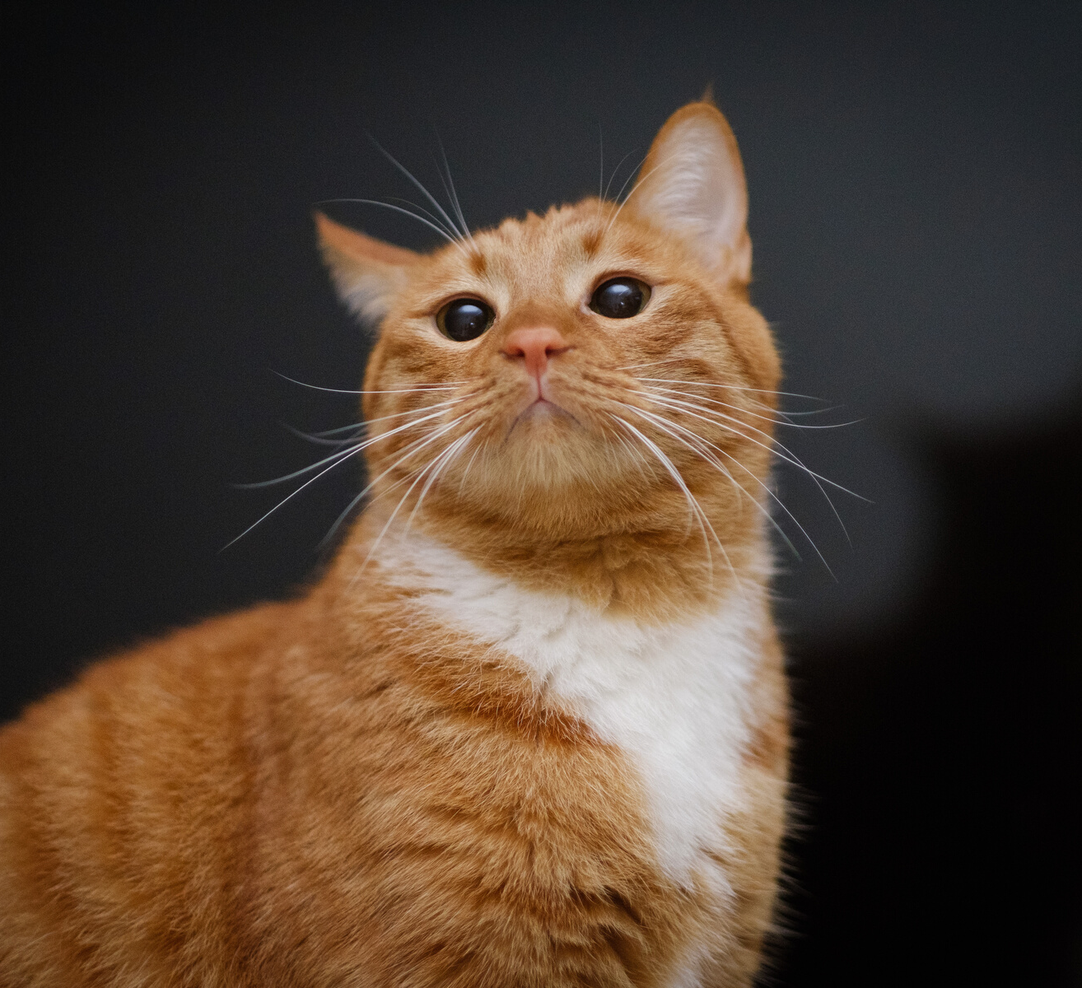
Technologies
- Spring Boot
- Spring Security
- Spring Data JPA
- Hibernate
- Mysql
- REST
- Ajax
- Thymeleaf
- Bootstrap
- HTML, CSS, js
- JUnit
- Rest Assured

Slide 6
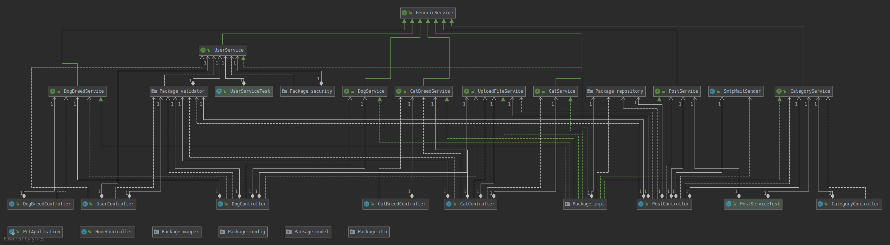
Class diagram

Slide 7
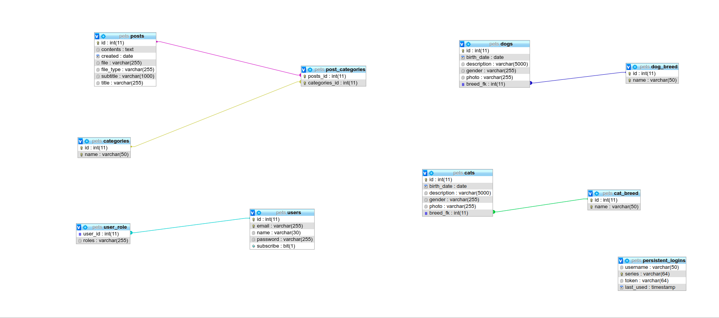
DB diagram

Slide 8
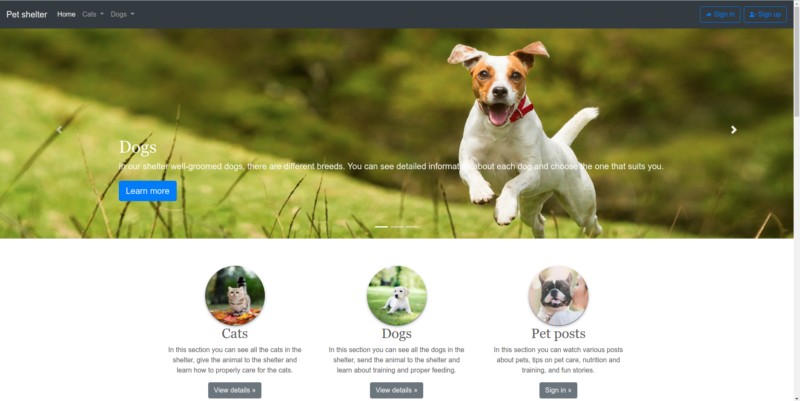
Without authentication

Slide 9
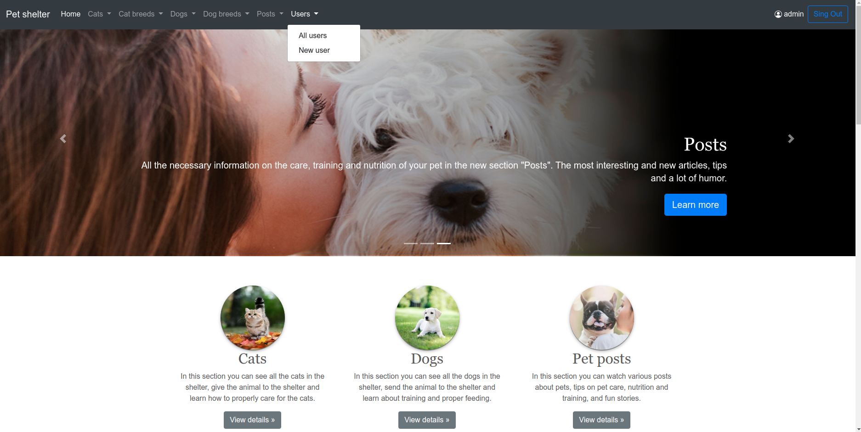
Role admin

Slide 10
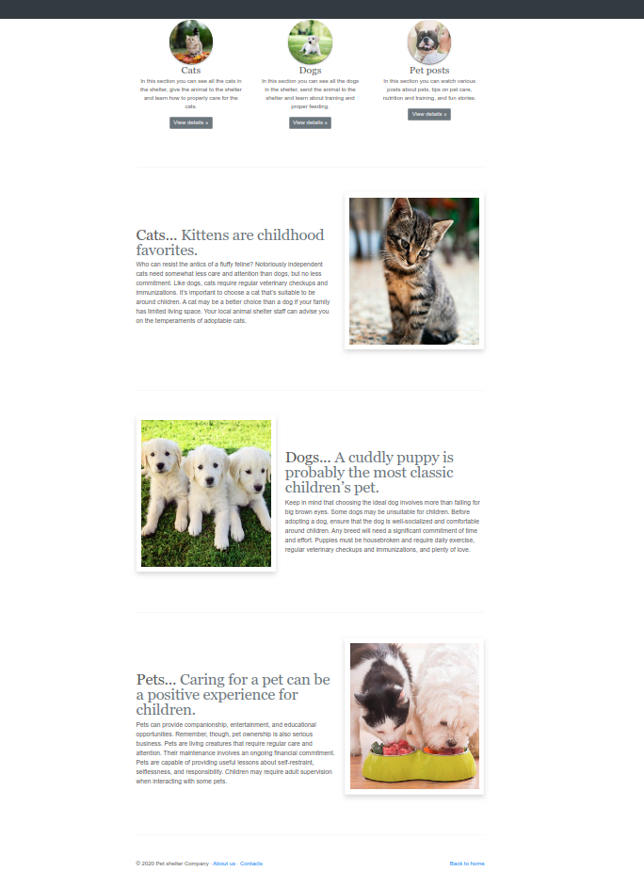
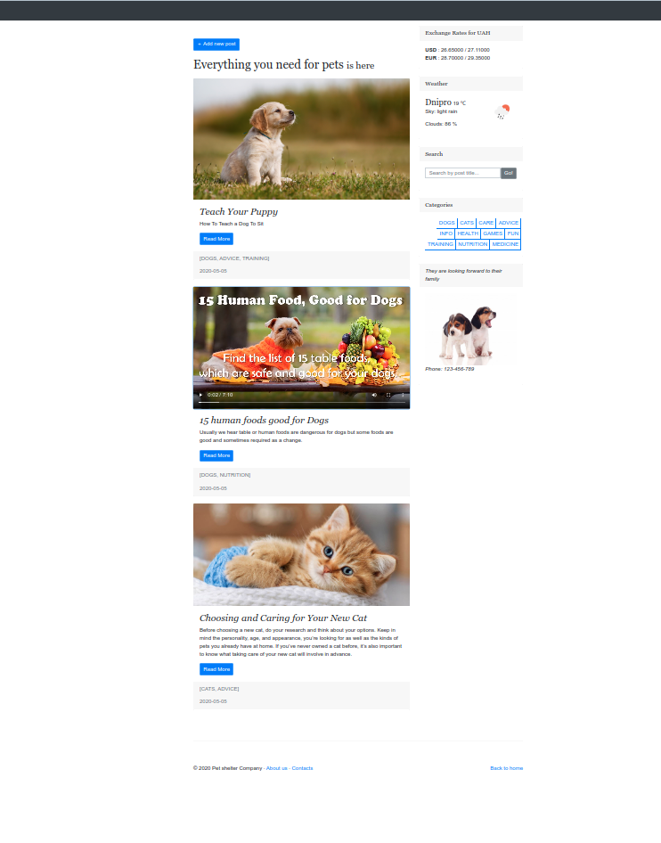
Main page
Posts

Slide 11
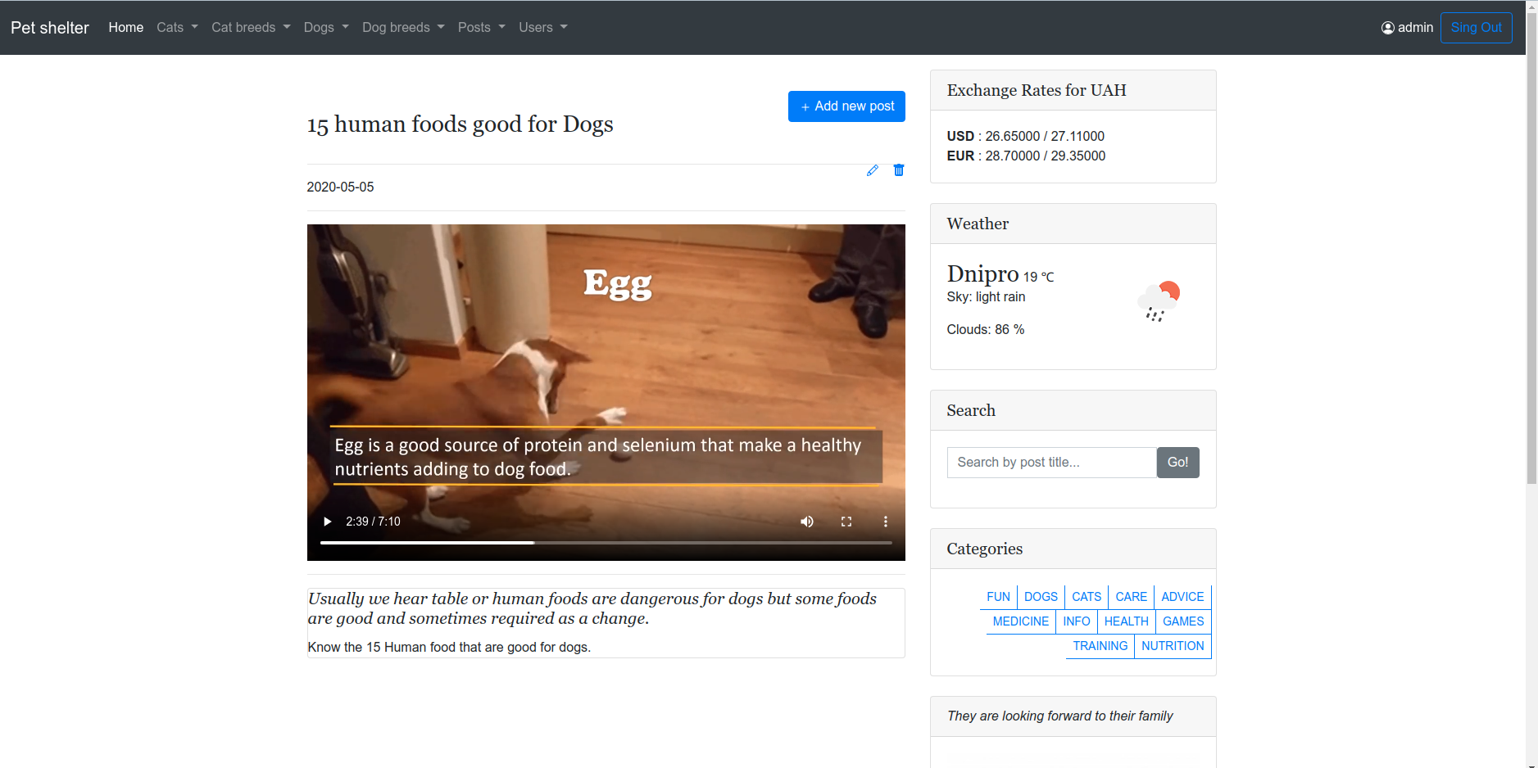
View post

Slide 12
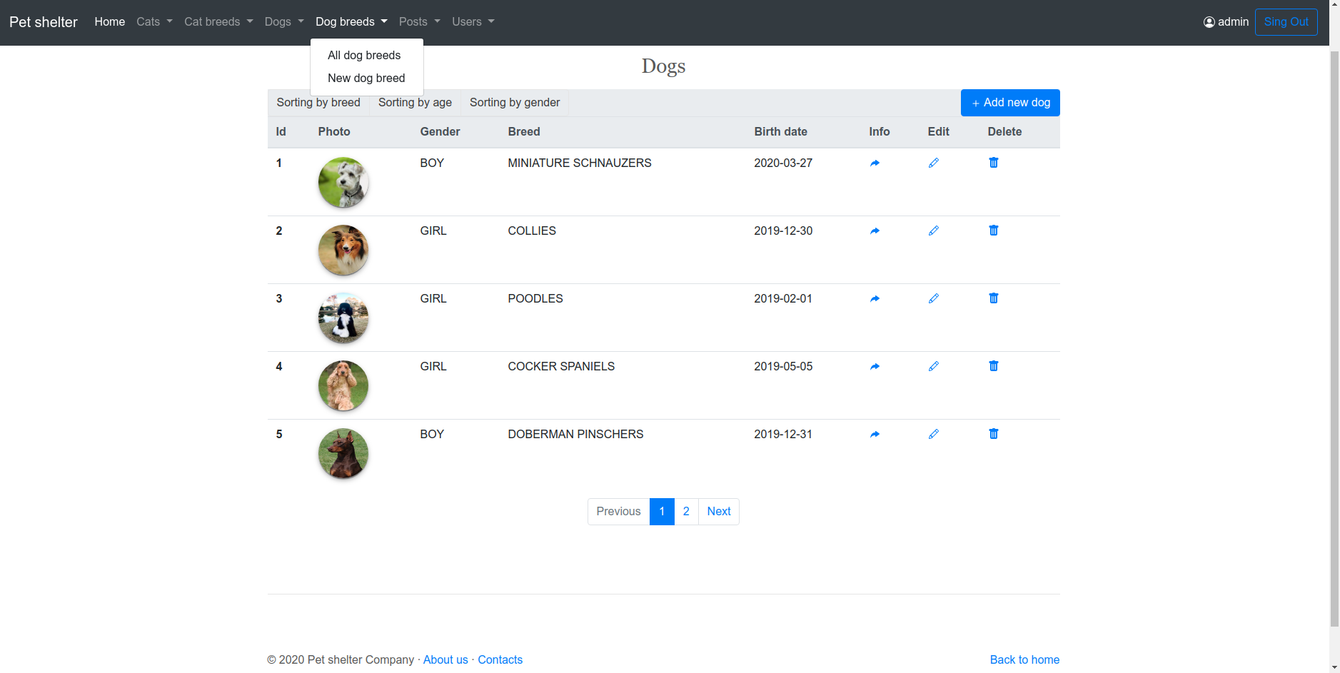
Dogs section

Slide 13
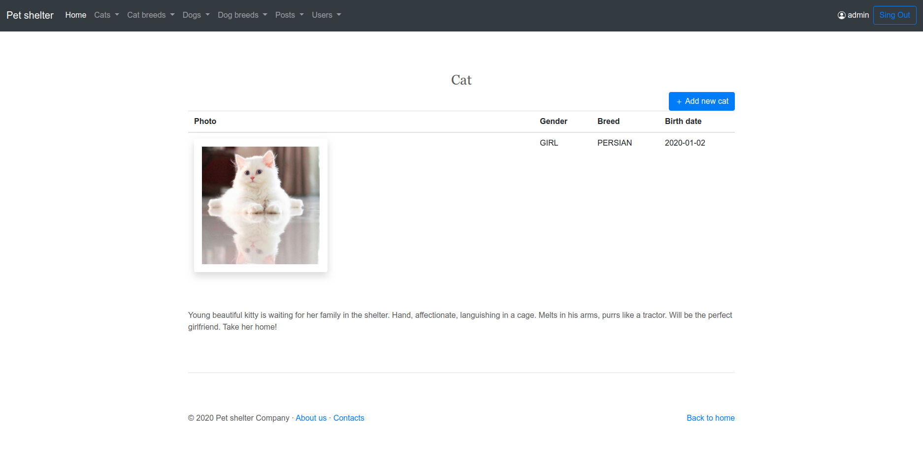
Cat info

Slide 14
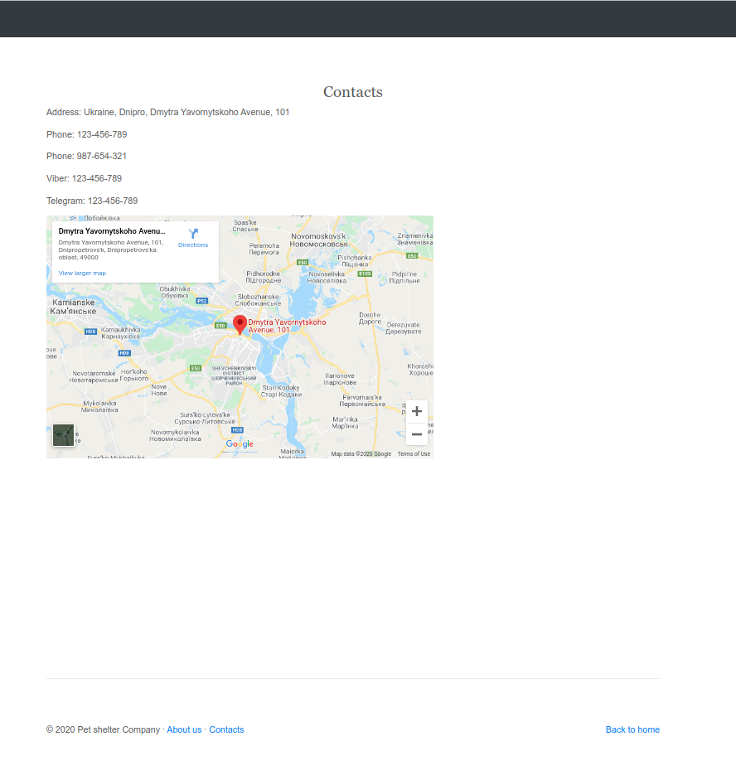
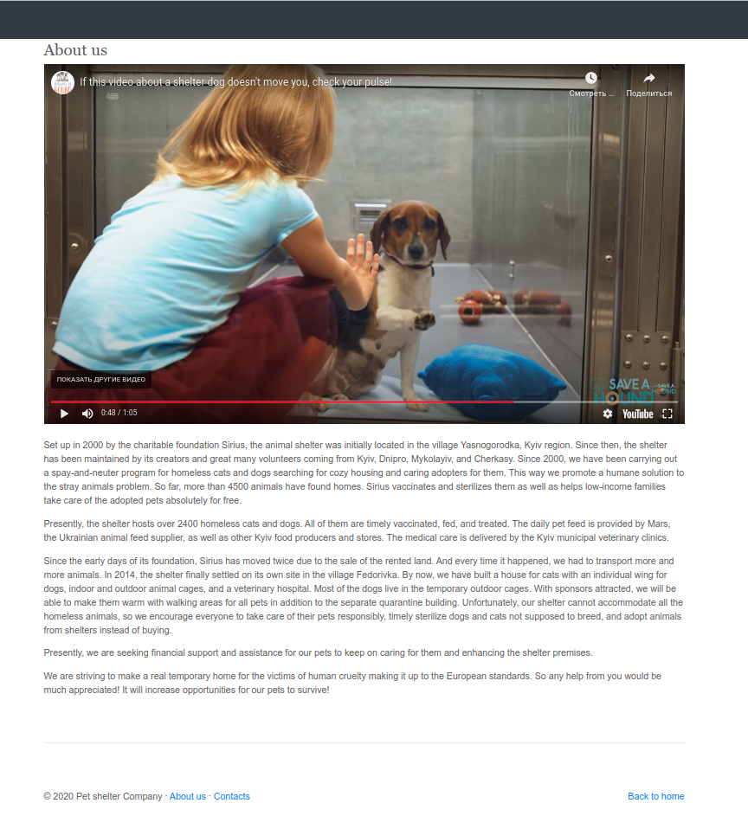
Footer

Slide 15
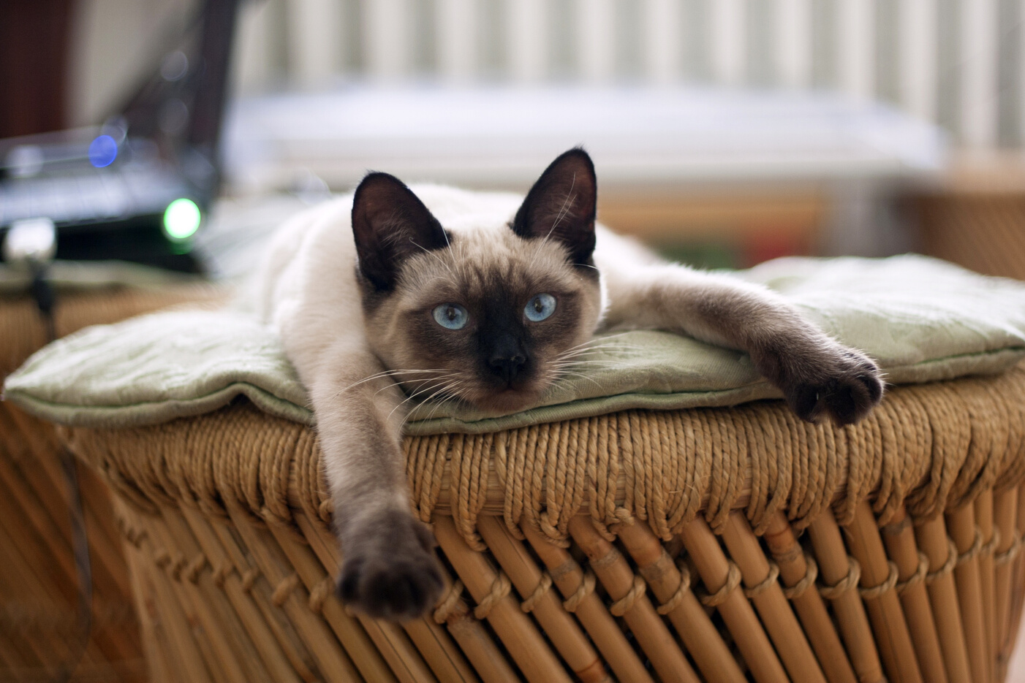
Thank you for the attention

